Slide 1
HAWASSA UNIVERSITY
College of Education
Department of Special Needs and Inclusive Education Inclusiveness SNIE 1012
By: Getahun S.

Slide 2
Chapter 1: Understanding Disabilities and Vulnerabilities

Slide 3
1.1. Definitions of basic Terms and concepts
Impairment
Any loss or abnormality of psychological, physiological, or anatomical structure or function.
(e.g., a missing limb)
Impairments are problems in body function or structure as a significant deviation or loss.
Body functions are the physiological functions of body systems (including psychological functions)
Impairments represent a deviation from certain generally accepted population standards.

Slide 4
The presence of impairments do not necessarily indicate that a disease is present or that the individual should be regarded as sick.
Impairments can be temporary or permanent; progressive, regressive or static; intermittent or continuous.
Disability
Restriction or lack (resulting from an impairment) of ability to perform an activity in the manner or within the range considered normal for a human being.

Slide 5
Disability is a condition caused by an accident, trauma, genetics or disease that may limit a person’s mobility, hearing, vision, speech or cognitive function.
It is incapacity recognized by law as limiting or preventing, for example, mobility.
A disability exists when an impairment limits a person’s ability to perform certain tasks (e.g., walk, see, etc)
It can be also be defined as a functional limitation

Slide 6
Major Life Activity
Basic activity that the average person in the general population can perform with little or no difficulty
Caring for one’s self
Performing manual tasks
Walking, talking, seeing, hearing, speaking, sleeping, standing, working, lifting, bending, breathing, speaking, learning, concentrating, thinking, major bodily functions, etc.

Slide 7
Handicap
It is a disadvantage for a given individual, resulting from impairment or a disability, that limits or prevents the fulfillment of a role that is normal for that individual (in relation to age, sex, social and cultural factors)
A person with a disability is not handicapped, unless the disability leads to educational, personal, social, vocational, or other problems.
it is a disadvantage that a person with a disability or impairment encounters when interacting with the environment.
It is a physical or attitudinal constraint imposed upon a person, regardless of whether that person has a disability or not

Slide 8
It is defined as “the loss or limitation of opportunities to take part in the normal life of the community on an equal level with others due to physical or social barriers”.
NOTE:
a disability may pose a handicap in one environment but not in another.
People with disabilities may experience handicap regardless of their disability because of other people’s negative attitude
Although the terms impairment , disability , and handicap are sometimes used interchangeably, they are not synonymous.

Slide 9
Disability and Handicap
Disability is viewed as a difference, a characteristic that sets an individual apart from everyone else,
Something that makes the individual less able or inferior.
Disability is seen as a deviance from the norm in which the other population is considered normal.
The way the society views the disability restricts the individual’s ability.
Therefore, an individual becomes handicapped because of the societies attitude.

Slide 10
Examples of impairment, disability and handicap
1 | Impairment | deformed inner ear
 | Disability | inability to hear or understand verbal communication
 | Handicap | Unable to attend school because the teachers do not know how to work with children who are deaf
2 | Impairment | Paralysed muscle
 | Disability | Difficulty walking, inability to use one hand
 | Handicap | Unable to obtain employment because there is no adequate public transport and because potential employers do not wish to hire some one with a disability
3 | Impairment | Mild mental retardation
 | Disability | Difficulty learning
 | Handicap | Unable to attend school because the teachers do not know how to work with children who have mental retardation

Slide 11
Causes of disability
Some people, especially in the past times, believe that disability is a punishment from God.
How do you see it?
Q. What do you think is the causes of disability?
________________________________________________________________________________________
Which time is more sensitive? Pre-natal Per- natal or
Post- natal?

Slide 12
Some of the causes of disability are
Genetic Causes
Environmental / Life Events
Unknown Causes
Inaccessible environments

Slide 13
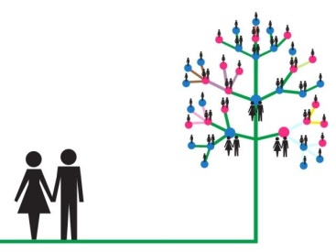
Disability can be caused by the following factors.
Genetic Causes
Abnormalities in genes and genetic inheritance can cause intellectual disability in children.
In some countries, Down syndrome is the most common genetic condition.
Down's syndrome is born with an extra chromosome, that affect both mental and physical.
Sometimes, diseases, illnesses, and over-exposure to x-rays can cause a genetic disorder.
Notes:
Down's syndrome is a genetic disorder caused when abnormal cell division results in extra genetic material from chromosome 21.

Slide 14
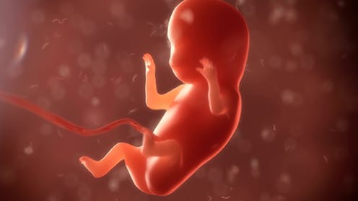
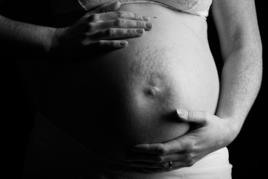
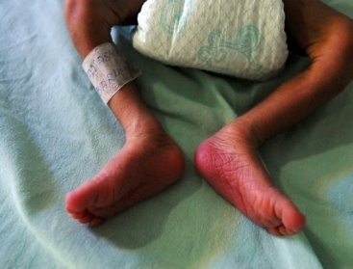
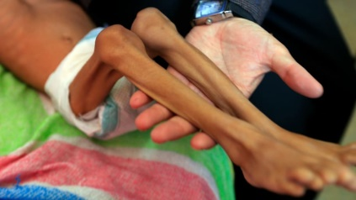
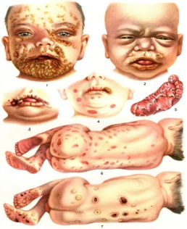
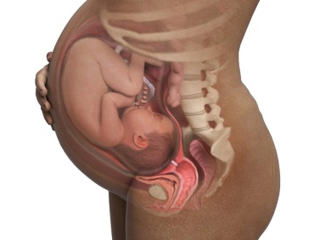
Environmental
Poverty and malnutrition in pregnant mothers can cause a deficiency in vital minerals and result in deformation issues in the unborn child.
After birth, poverty and malnutrition can also cause poor development of vital organs in the child, which can eventually lead to disability.
The use of drugs, alcohol, tobacco, the exposure to certain toxic chemicals and illnesses, syphilis by a pregnant mother can cause intellectual disability to the child.

Slide 15
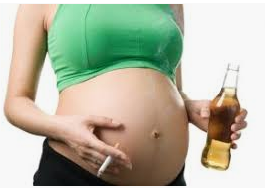
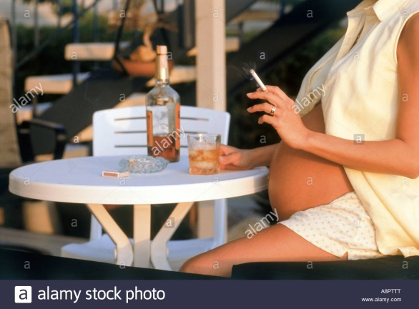
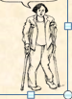
Toxic material such as lead and mercury can damage the brain too.
Unfortunate life events such as drowning/ sinking, automobile accidents, falls and so on can result in people
losing their sight, hearing, limbs and other vital parts of their body and cause disability.

Slide 16
Unknown Causes
The human body is a phenomenal thing.
Scientists have still not figured out what and how some things in the body, cells, brain, and genes come about.
Humans have still not found all the answers to all the defects in the human body

Slide 17
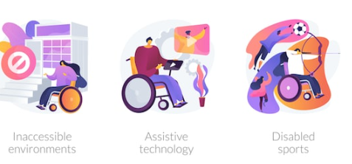
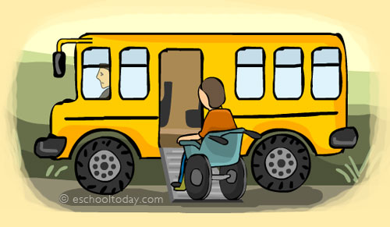
Inaccessible environments
When society develops infrastructure such as houses, roads, parks and other public places should consider people with impairment,
For example, if a school is built with a ramp in addition to stairs, it makes it easy for people with wheelchairs to move about freely.
Lack of education, support services, health and opportunities for people with impairment can cause additional disability to people with disabilities and even people with no disability.

Slide 18
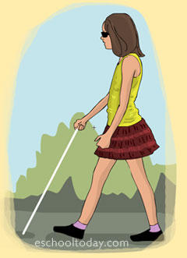
Some type of disabilities
Some nine major disabilities are listed and briefly discussed as follows
1. Visual impairment
Visual impairment in general designates two sub- classifications. These are blindness and low vision.
Blindness, total or partial inability to see because of disease or disorder of the eye, optic nerve, or brain. The term blindness typically refers to vision loss that is not correctable with eyeglasses or contact lenses.

Slide 19
Partial blindness means a person who have very limited vision.
Complete blindness means a person who cannot see anything and DO NOT see light.
The term low vision is used for moderately impaired vision.
People with low vision may have a visual impairment that affects only central vision.

Slide 20
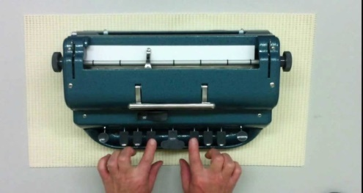
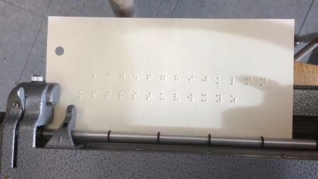
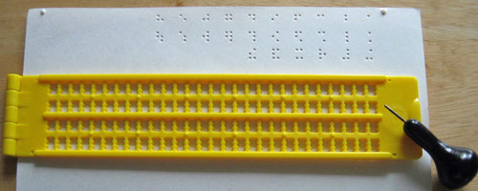
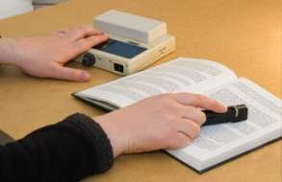
Braille and its associates such as Braillewriter, slate and stylus are essential tactile aids for educational tasks of persons with visual impairments.
A Braille is a compact and portable machine that uses keys and when pressed down embosses special paper with the Braille code.
Braillewriter is a six- key machine manually operated and types Braille
Slate and stylus: the slate is a metal frame with openings of the size of the Braille dots; the stylus is a pointed object used to emboss the dots.
Optacon is an instrument that scans printed material and converts it to tactually readable print format.

Slide 21
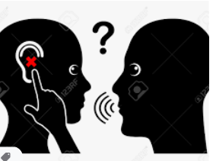
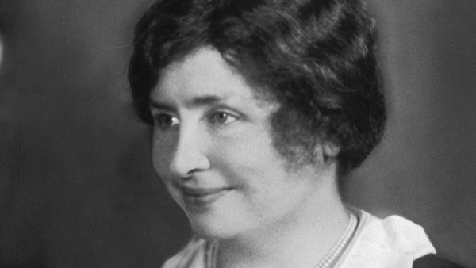
2. Hearing Impairment
Different people define the term hearing impairment differently.
Pasonella and Carat from legal point of view, define hearing impairment as
a generic term indicating a continuum of hearing loss from mild to profound, which includes the sub-classifications of the hard of hearing and deaf.

Slide 22
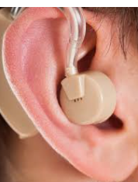
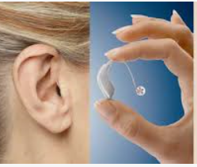
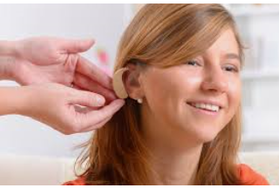
Hard of Hearing: "A hearing impairment, whether permanent of fluctuating, which adversely affects a child's educational performance but which is not included under the definition of 'deaf'." Whelan, R. J. (1988).
This term can also be used to describe persons with enough (usually with hearing aids) as a primary modality of acquisition of language and in communication with others.

Slide 23
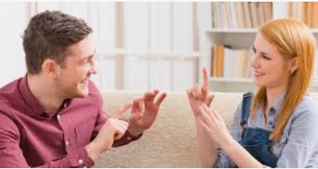
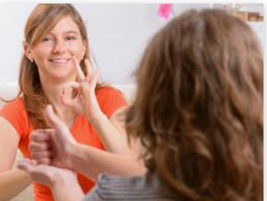
Deaf: Those who have difficulty understanding speech, even with hearing aids but can successfully communicate in sign language.

Slide 24
The effective teaching of hearing impaired students
Providing language instruction
Teaching small groups of hearing impaired students who function on different levels.
Developing and adopting instructional materials and enhancing positive self concept.
Present lecture information in a visual format (e.g., chalkboard, overheads, PowerPoint slides, handouts, etc.).
Provide hand-outs in advance

Slide 25
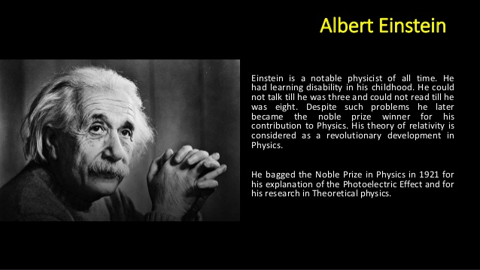
3. Specific learning disability
Specific Learning Disability means a disorder in one or more of the basic psychological processes involved in understanding or in using language,
spoken or written,
that may manifest itself in the imperfect ability to
listen, think, speak, read, write, spell, or to do mathematical calculations.

Slide 26
Generally speaking, people with learning disabilities are of average or above average intelligence.
There often appears to be a gap between the individual’s potential and actual achievement.
This is why learning disabilities are referred to as hidden disabilities:
the person looks perfectly “normal” and seems to be a very bright and intelligent person,
yet may be unable to demonstrate the skill level expected from someone of a similar age.

Slide 27
A learning disability cannot be cured or fixed; it is a lifelong challenge.
However, with appropriate support and intervention, people with learning disabilities can achieve success in school, at work, in relationships, and in the community.

Slide 28
Types of Specific Learning Disabilities
Auditory Processing Disorder (APD)
Also known as Central Auditory Processing Disorder
Individuals with APD do not recognize subtle differences between sounds in words, even when the sounds are loud and clear enough to be heard.
They can also find it difficult to
tell where sounds are coming from,
make sense of the order of sounds,

Slide 29
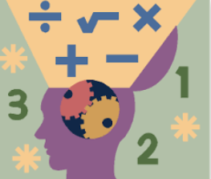
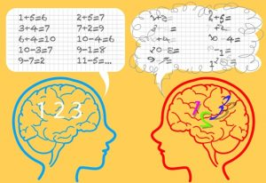
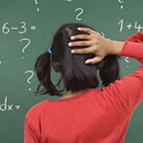
A. Dyscalculia
Dyscalculia is a specific learning disability that affects a person‘s ability to understand numbers and learn math.
impaired ability to understand and perform mathematics
Dyscalculia means inability to calculate

Slide 30

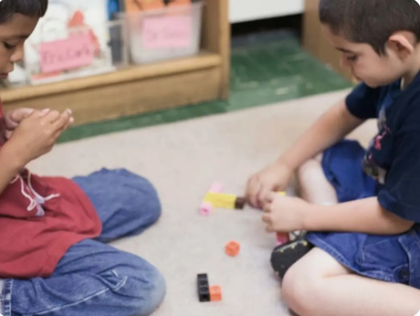
B. Dysgraphia
Dysgraphia is a specific learning disability that affects a person‘s handwriting ability and fine motor skills. Problems may include
illegible handwriting,
Dysgraphia means impaired in letter writing skill (difficulty in writing)
Fine motor skill

Slide 31
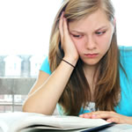

C. Dyslexia
Dyslexia is a specific learning disability that affects reading and related language-based processing skills.
The severity can differ in each individual but can affect reading fluency, decoding, reading comprehension, recall, writing, spelling, and sometimes speech and can exist along with other related disorders.
Dyslexia:- a reading disability (the student has trouble reading written words fluently, out loud).

Slide 32
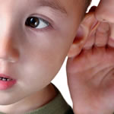
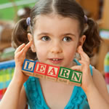
D. Language Processing Disorder
Language Processing Disorder is a specific type of Auditory Processing Disorder (APD) in which there is difficulty attaching meaning to sound groups that form words, sentences and stories.
While an APD affects the interpretation of all sounds coming into the brain,
a Language Processing Disorder (LPD) relates only to the processing of language.
LPD can affect expressive language and/or receptive language.

Slide 33
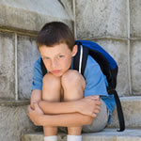
E. Non-Verbal Learning Disabilities
Typically, an individual with Non-Verbal Learning Disabilities (NLD or NVLD) has trouble interpreting nonverbal cues like facial expressions or body language, and may have poor coordination.

Slide 34
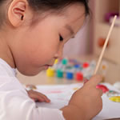
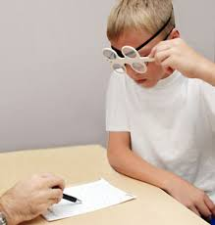
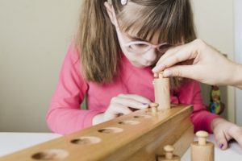
F. Visual Perceptual/Visual Motor Deficit
Visual Perceptual/Visual Motor Deficit is a disorder that affects the understanding of information that a person sees, or the ability to draw or copy.

Slide 35
4. Speech and Language Impairments
Speech and language impairment means a communication disorder such as
stuttering, impaired articulation, language impairment, or a voice impairment that adversely affects a child‘s educational performance.
It is disorder that adversely affects the child's ability to talk, understand, read, and write.
This disability category can be divided into two groups: speech impairments and language impairments.

Slide 36
Speech Impairments
There are three basic types of speech impairments:
articulation disorders,
fluency disorders, and
voice disorders
Articulation disorders are errors in the production of speech sounds that may be related to anatomical or physiological limitations in the skeletal, muscular, or neuromuscular support for speech production.
These disorders include:
Omissions: (bo for boat)
Substitutions: (wabbit for rabbit)
Distortions: (shlip for sip) and
Add extra sound ( bahrawn for brown)

Slide 37
Fluency disorders are difficulties with the rhythm and timing of speech characterized by hesitations, repetitions, or prolongations of sounds, words, or phrases.
Common fluency disorders include:
Stuttering: rapid-fire repetitions of consonant or vowel sounds especially at the beginning of words, prolongations, hesitations, interjections, and complete verbal blocks
Cluttering: excessively fast and jerky speech

Slide 38

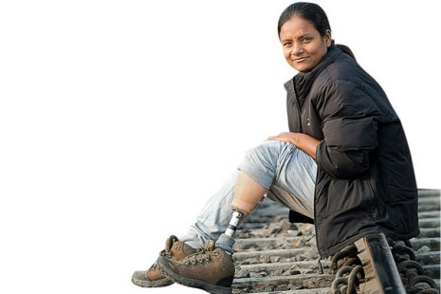
Voice disorders are problems with the quality or use of one's voice resulting from disorders in the larynx.
Voice disorders are characterized by abnormal production and/or absences of vocal quality, pitch, loudness, resonance, and/or duration.

Slide 39
Language Impairments
There are five basic areas of language impairments:
Phonological disorders are defined as the abnormal organization of the phonological system, or a significant deficit in speech production or perception.
A child with a phonological disorder may be described as hard to understand or as not saying the sounds correctly.
Morphological disorders are defined as difficulties with morphological inflections (inflections on nouns, verbs, and adjectives that signal different kinds of meanings).

Slide 40
Semantic disorders are characterized by poor vocabulary development, inappropriate use of word meanings, and/or inability to comprehend word meanings.
These students will demonstrate restrictions in word meanings, difficulty with multiple word meanings, excessive use of nonspecific terms (e.g., thing and stuff), and indefinite references (e.g., that and there).

Slide 41
Pragmatic difficulties are characterized as problems in understanding and using language in different social contexts.
These students may lack an understanding of the rules for making eye contact, respecting personal space, requesting information, and introducing topics.

Slide 42
5. Autism
Autism means a developmental disability significantly affecting verbal and nonverbal communication and social interaction, generally evident before age three that adversely affects a child‘s educational performance.
Other characteristics often associated with autism are engaging in
repetitive activities and stereotyped movements,
resistance to environmental change or change in daily routines, and
unusual responses to sensory experiences.

Slide 43
Children with autism vary literally in their use of words, (Rutter, 1966).
Communication deficiencies may leave a lasting mark of social retardation on the child.

Slide 44
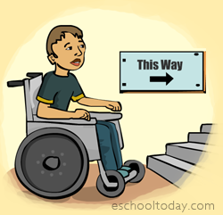
6. Emotional and Behavioral Disorders
Emotional and Behavioral Disorders adversely affects educational performance in one or more of the following
1) An inability to learn that cannot be explained by intellectual, sensory, or health factors;
2) An inability to build or maintain satisfactory interpersonal relationships with peers and teachers;
3) Inappropriate types of behavior or feelings under normal circumstances;
4) A general pervasive mood of unhappiness or depression; or
5) A tendency to develop physical symptoms or fears associated with personal or school problems.

Slide 45
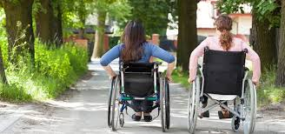
Classification of behavioral and emotional disorders
Different classification systems of behavioral and emotional disorders can be used for special education, These include:
Conduct disorder: individuals may seek attention, are disruptive and act out.
Socialized aggression: individuals join subculture group of peers who are openly disrespectful to their peers, teachers, and parents. Early symptoms include stealing, running away from home, habitual lying

Slide 46
Attention problems- These individuals may have attention deficit, are easily destructible and have poor concentration.
Anxiety/Withdrawn- These individuals are self-conscious, reserved, and unsure of themselves.
They typically have low self-esteem and withdraw from immediate activities.

Slide 47
Psychotic behavior: These individuals show more bizarre behavior.
They may hallucinate, deal in a fantasy world and may even talk in gibberish.
Motor excess: These students are hyperactive.
They cannot sit nor listen to others nor keep their attention focused.

Slide 48
Kauffman (1993) conclude that emotion or behavioral disorders fall into two broad classifications:
1) Externalizing Behavior: also called under controlled disorder, include such problems disobedience, disruptiveness, fighting, tempers tantrums, irresponsibility, jealous, anger, attention seeking etc…
2) Internalizing Behavior: also known as over controlled disorders, include such problems anxiety, immaturity, shyness, social withdrawal, feeling of inadequacy (inferiority), guilt, depression and worries a great deal

Slide 49
Causes of behavioral and emotional disorders
Behavioral and emotion disorders result from many causes, these includes the following.
1. Biological- includes genetic disorders, brain damage, and malnutrition, allergies, temperament and damage to the central nervous system.
2. Family factors- include family interactions, family influence, child abuse, neglect, and poor disciplinary practices at home.
3. Cultural factors- include some traditional and cultural negative practices, for example watching violence and sexually oriented movies and TV programs.
4. Environmental factors- include peer pressure, living in impoverished areas, and schooling practices that are unresponsive to individual needs.

Slide 50
7. Intellectual Disability
Intellectual disability is a disability characterized by significant limitations in both intellectual functioning and in adaptive behavior, which covers many everyday social and practical skills.
This disability originates before the age of 18.
Following are the three criteria to consider an individual to have an intellectual disability :

Slide 51
Sub average intellectual functioning: It refers to general mental capacity, such as
learning, reasoning, problem solving, and so on. One way to measure intellectual functioning is an IQ test (Intelligence quotient).
Generally, an IQ test score of around 70 or as high as 75 indicates a limitation in intellectual functioning.
2. Significant limitations exist in two or more adaptive skill areas: It is the collection of
conceptual,
social, and
practical skills that are learned and performed by people in their everyday lives.

Slide 52
Conceptual skills—language and literacy; money, time, and number concepts; and self-direction.
Social skills—interpersonal skills, social responsibility, self-esteem, gullibility, innocence (i.e., suspicion), social problem solving, and the ability to follow rules/obey laws and to avoid being victimized.
Practical skills—activities of daily living (personal care), occupational skills, healthcare, travel/transportation, schedules/routines, safety, use of money, use of the telephone.

Slide 53
People with intellectual disabilities academic learning can be affected, as well as their ability to adapt to home, school, and community environments are presented under the following sub-headings:
General Cognition: People with intellectual disabilities vary physically and emotionally, as well as by personality, disposition, and beliefs.
Their apparent slowness in learning may be related to the delayed rate of intellectual development (Wehman, 1997).

Slide 54
Learning and Memory: The learning and memory capabilities of people with intellectual disabilities are significantly below average in comparison to peers without disabilities.
Children with intellectual disabilities may not spontaneously use appropriate learning or memory retention strategies and
may have difficulty in realizing the conditions or actions that aid learning and memory.

Slide 55
Attention: To acquire information, children must attend to the learning task for the required length of time and control distractions.
Children with intellectual disabilities may have difficulty distinguishing and attending to relevant questions in both learning and social situations
Adaptive Skills: A child with intellectual disabilities may have difficulty in both learning and applying skills for a number of reasons, including
a higher level of distractibility, inattentiveness, failure to read social cues, and impulsive behavior (Hardman et al., 2008).

Slide 56
Speech and Language: People with intellectual disabilities may have delayed speech, language comprehension and formulation difficulties.
People with intellectual disabilities may show delayed functioning on pragmatic aspects of language, such as
turn taking,
selecting acceptable topics for conversation,
knowing when to speak
knowing when to be silent

Slide 57
Physical characteristics: Children with intellectual disabilities with differing biological etiologies, may exhibit coexisting problems, such as
physical, motor, orthopedic, visual and auditory impairments, and health problems

Slide 58
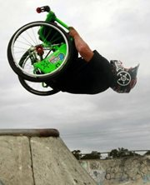
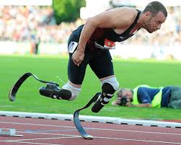
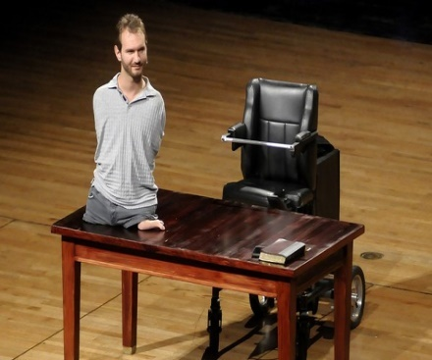
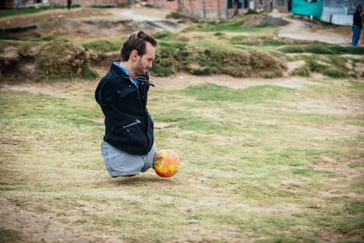
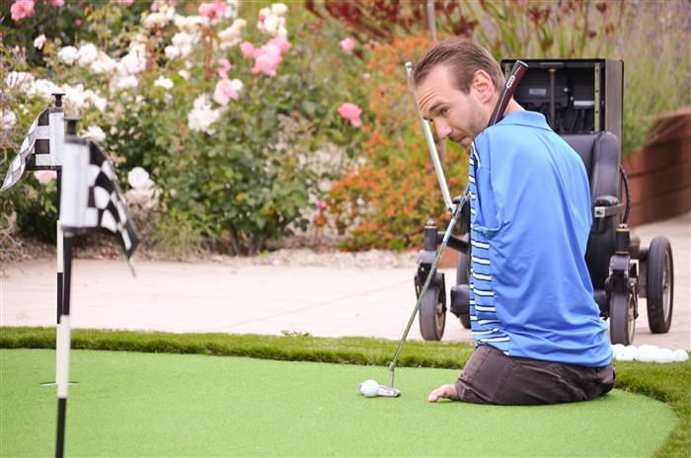
8. Physical disability/Orthopedic
Health impairment and Physical disability is a condition that interferes with the individual‘s ability to use his or her body.
Many but not all, physical disabilities are orthopedic impairments.
(The term orthopedic impairment generally refers to conditions of muscular or skeletal system and sometimes to physical disabling conditions of the nervous system).

Slide 59


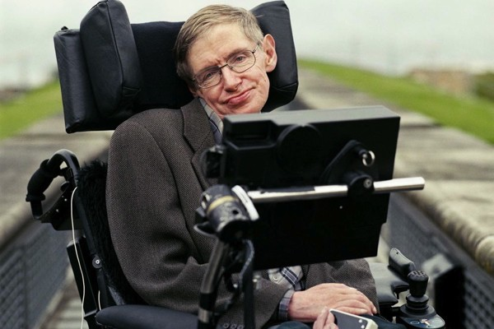
Motivation: People with intellectual disabilities are often described as lacking motivation, or outer-directed behavior.
Academic Achievement: The cognitive difficulties of children with mild to moderate intellectual disabilities lead to persistent problems in academic achievement unless intensive and extensive supports are provided.

Slide 60
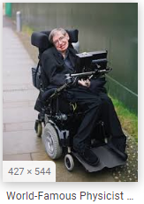
Levels and areas of support for intellectual disabilities
Levels of support range from intermittent (just occasional or “as needed” for specific activities) to pervasive (continuous in all realms of living).

Slide 61
Classifying physical impairment
Physical disabilities:- based on the impact of physical disability on mobility and motor skills, it is divided into three. These are:-
Mild physical disability:- these individuals are able to walk without aids and may make normal developmental progress.
Moderate physical disability:- individuals can walk with braces and crutches and may have difficulty with fine-motor skills and speech production.
Severe physical disability:-these are individuals who are wheel-chair dependent and may need special help to achieve regular development.

Slide 62
The physical disability could be broadly classified in to two
The neurological system (the brain, spinal cord & nerve) related problems.
Musculo skeletal system ( the muscles, bones and joints) are deficient due to various causes.

Slide 63
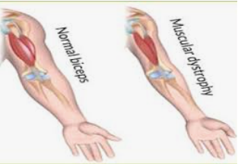
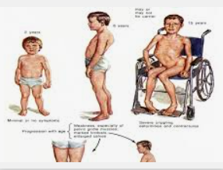
The list of the impairment and associated with musculoskeletal malformation are the following:
Muscular dystrophy:- is an inherited condition accruing mainly in males, in which the muscles weaken and deteriorate.
The weakness usually appears around 3 to 4 years of age and worsens progressively.
By age 11 most victims can to longer walk.
Death usually comes between the ages of 25 and 35 from respiratory failure or cardiac arrest.

Slide 64
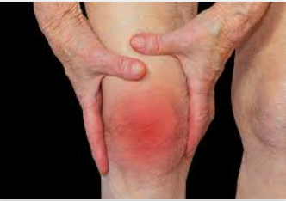
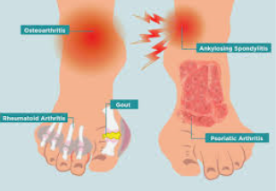



Arthritis:-is an inflammation of the joints. Symptoms include swollen and stiff joints, fever, and pain in the joints during acute periods.
Amputation:- a small number of children have missing limbs because of congenital abnormalities or injury or disease (malignant bone tumors in the limbs).
These children can use customized prosthetic devices (artificial hands, arms, or legs)

Slide 65


Marfan syndrome is a genetic disorder in which the muscles are poorly developed and the spine is curved.
They may have either long, thin limbs, prominent shoulder blades, spinal curvature, flat feet, or long fingers & thumbs.
Individuals with marfan syndrome need to avoid heavy exercise and lifting heavy objects.

Slide 66


Achondroplasis:- is a genetic disorder that affects 1 in 10,000 births.
Children with this disorder usually develop a normal torso but have a straight upper back and a curved lower back (sway back).
These children are at risk of sudden death during sleep from compression of the spinal cord interfering with their breathing.
The disability may be lessened through the use of the back braces or by surgery.

Slide 67





Polio:- is viral disease that invade the brain and cause severe paralysis of the total body system.
In its mild form results in partial paralysis.
Club foot:- is a major orthopedic problem affecting about 9,000 infants each year.
This term is used to describe various ankle or foot deformities, i.e.
Twisting inward (equino varus), the most severe form
Sharply angled at the heel (calcanel vaigus), most common
The front part of the foot turned inward.

Slide 68
These conditions can be treated with physical therapy, and a cast on the foot can solve the problem in most instances.
In more severe cases, surgery is necessary.
With early treatment, most children can wear regular shoes and take part in all school activities.

Slide 69



Cleft lip and cleft palate:- are openings in the lip or roof of the mouth, respectively, that fail to close before birth, the cause is unknown.
Most cleft problems can be repaired through surgery.

Slide 70


9. Health Impairments
These disease caused problems are as follow.
Heart disease:- this is common among young people.
It is caused by improper circulation of blood by the heart some of the disorders are congenital) present at birth);others are the product of inflammatory heart disease.
Some students have heart valve disorders; others have disorders of the blood vessels. His time heart implantation helps children to get cured.

Slide 71


2. Cystic fibrosis:- is a hereditary disease that affects the lungs and pancreas.
It leads to recurrent respiratory and digestive problems including abnormal amounts of thick mucus, sweet and saliva.
Children with such disease often spend significant timeout of school.

Slide 72



3. Acquired immune deficiency syndrome (AIDS):- is a very severe disease caused by human immunodeficiency virus (HIV) infection and transmitted primarily
through exchange of bodily fluids in transfusions or
unprotected sex, and by
contaminated needles in addictive drug use.

Slide 73




4. Hemophilia:- is a hereditary disease in which the blood clots very slowly or not all.
The disorder is transmitted by sex-linked recessive gene and nearly always occurs in males.
5. Asthma: is a chronic respiratory condition characterized by repeared eplosde of breathing difficulties especially while exhaling.

Slide 74




6. Diabetes: Developmental or hereditary disorder characterized by inadequate secretion or use of insulin
7. Nephrosis & Nephritis Kidney disorders or diseases caused by infections, poisoning, burns, accidents or other diseases
8. Sickle-cell anemia Hereditary and chronic blood disease (occurring primarily in African Americans) characterized by red blood cells that are distorted and that do not circulate properly
9. Leukemia: Disease characterized by excessive production of white blood Cells

Slide 75



10. Lead poisoning Disorder caused by ingesting lead-based paint chips or other substances containing lead
11. Tuberculosis Infectious disease that commonly affects the lungs and may affect other tissues of the body.
12. Cancer Abnormal growth of cells that can affect any organ system

Slide 76
9. Vulnerability
Vulnerable means being at risk of being harmed.
In principle, everyone is vulnerable to some adverse event or circumstance, but some people are more vulnerable than others.
For instance, people with disabilities are more likely as a group to experience greater vulnerability.
They are also often more severely affected by the vulnerability they experience.
Based on the existing literature, vulnerability can be generally defined as a complex phenomenon that refers to the following dimensions:

Slide 77
Hence, Vulnerability is
- The quality or state of being exposed to the possibility of being attacked or harmed, either physically or emotionally.
It is the quality of being easily hurt or attacked.

Slide 78
At Risk
It refers to children who, although not currently identified as having a disability, are considered to have a greater than usual chance of developing one.
Educators often apply the term to:
infants and preschoolers who, because of biological conditions, events surrounding their births, or environmental deprivation, may be expected to experience developmental problems at a later time.
The term is also used to refer to:
students who are experiencing significant learning or behavioral problems in the general education classroom and are therefore at risk of being diagnosed with a disability.

Slide 79
Dimensions of Vulnerabilities
1. Economic difficulties/lack of financial resources: poverty, low living standards, housing problems (e.g. too damp, too expensive, too cold or difficult to heat) etc.;
2. Social exclusion: limited access to facilities such as transportation, schools, libraries or medical services;
3. Lack of social support from social networks: no assistance from family members, friends, neighbors or colleagues (referring to practical help as well as emotional support) like highly gifted individuals;

Slide 80
4. Stigmatization: being a victim of stereotypes, being devalued, confronted with disgraceful behavior because of belonging to a particular social or ethnic group;
5. Health difficulties: disadvantages resulting from poor mental health, physical health or disabilities;
6. Being a victim of crime: in family context especially of violence.

Slide 81
Causes of Vulnerability
Vulnerability may be causes by
rapid population growth,
poverty and hunger,
poor health,
low levels of education,
gender inequality,
fragile and hazardous location, and
lack of access to resources and services,
including knowledge and technological means, disintegration of social patterns (social vulnerability).

Slide 82
Other causes includes;
lack of access to information and knowledge,
lack of public awareness,
limited access to political power and representation (political vulnerability), (Aysan,1993).
When people are socially disadvantaged or lack political voice, their vulnerability is exacerbated / worsened/ further.

Slide 83
Characteristics of Vulnerable People
The following are thought to be characteristics of vulnerable people (with examples of groups of potentially vulnerable people):
1. Less physically or mentally capable (infants, older adults, people with disabilities)
2. Fewer material and/or financial resources (low-income households, homeless)
3. Less knowledge or experience (children, illiterate, foreigners, tourists)
4. Restricted by society to grow and develop according to their needs and potentials

Slide 84
People who are helped by others (who are then restricted by commitments) are still vulnerable people, which includes the following extracted from various researches.
A. Women: particularly women in developing nations and those who are living in rural areas are vulnerable for many backward traditional practices.
These women are oppressed by the culture and do not get access to education and employment.

Slide 85
B. Children: Significant number of children are vulnerable and at risk for development.
Children are vulnerable for psychological and physical abuse. This include
illegally working children, children who are pregnant or become mothers,
children born out of marriage, children from a single-parent,
delinquent children, homeless children,
HIV-infected children,
uneducated children,
married children,
mentally ill children,
migrant children, orphans, sexually exploited children,
street children, war-affected children…etc.

Slide 86
C. Minorities: some people are vulnerable due to their minority background. Particularly, ethnic (cultural and linguistic minority), religious minority.
These people are political and socially discriminated.
D. Poverty: People are vulnerable for many undesirable phenomena due to poverty. This may be resulted in,
poor households and large households,
inequality,
absences of access to health services,
important resources for life, lack of access to education, information,
financial and natural resources and lack of social networks

Slide 87
E. Disabilities: People with disabilities very much vulnerable for many kind of risks. This includes
abuses, poverty, illiteracy, health problems, psychological and social problems
F. Age: Old people or very young children are vulnerable for all kinds evils
G. Illiteracy and less education: People with high rates of illiteracy and lack quality educational opportunities are vulnerable for absence all kinds of developments

Slide 88
H. Sickness: Uncured health problems for example people living with HIV/AIDS are much vulnerable for psychosocial problems, poverty and health.
I. Gifted and Talentedness: Gifted and talented children are vulnerable for socio-emotional developments.
Due to lack of psychological support they may feel isolation as they are pulled from their regular classrooms and given instruction in separate settings and due to myths and expectations of themselves and the public

Slide 89
Thank you

